Slide 1


Disrupting business with blockchain
Mike Ormond, Microsoft Ltd
@MikeOrmond
"LEGO blocks (#0048)" (CC BY 2.0) by regan76 @ flickr

Slide 2
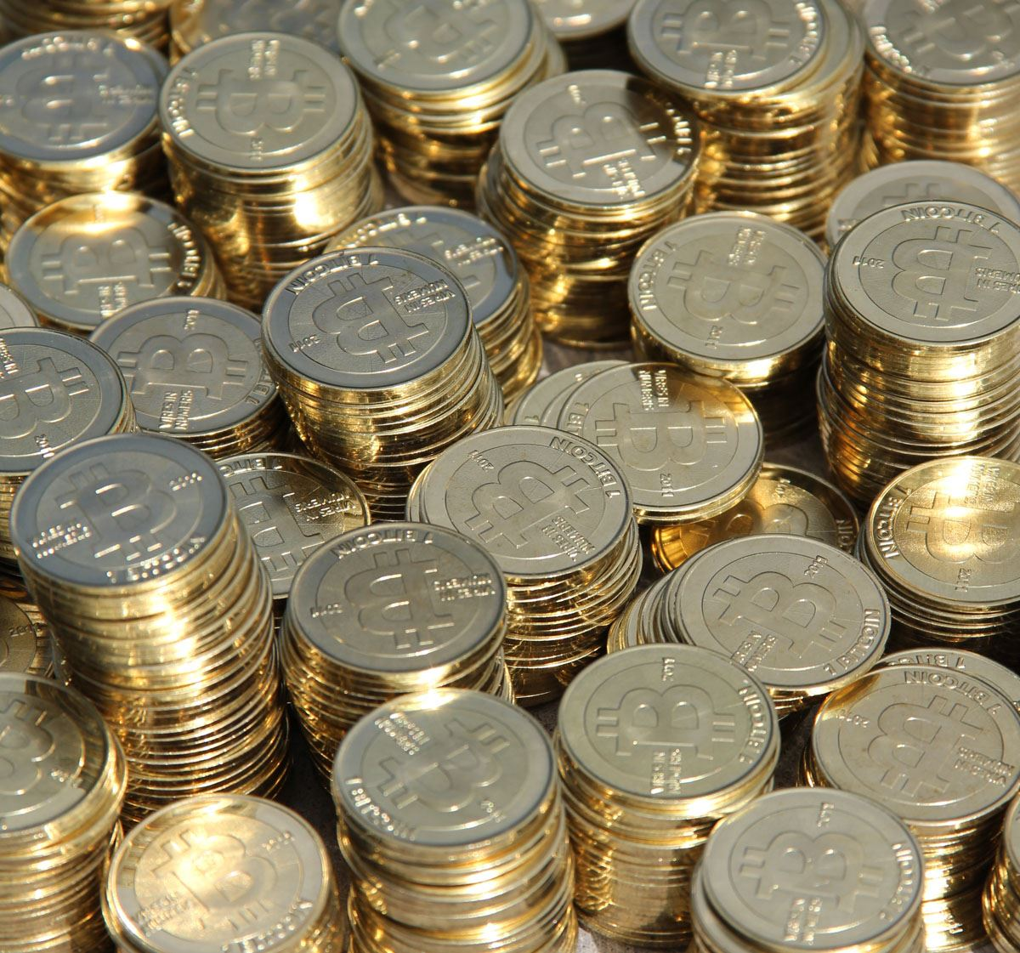
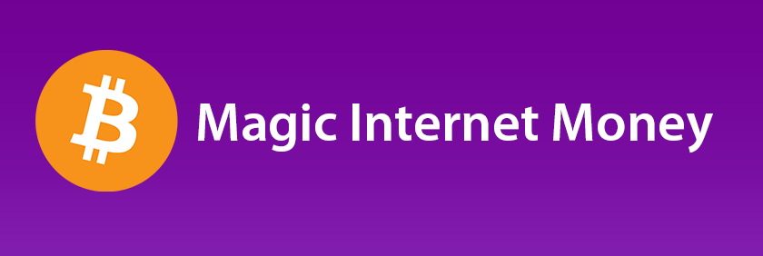
"bitcoin" (CC BY 2.0) by stevegarfield @ flickr
"bitcoin" (CC BY 2.0) by Sean MacEntee @ flickr

Slide 3

"Randy’s" (CC BY 2.0) by Extra Medium @ flickr

Slide 4

"599 HGTE." (CC BY 2.0) by Damian Morys Photography @ flickr

Slide 5

“Double Spend Problem”
"Blue And Pink Piggy Banks" (CC BY-SA 2.0) by kenteegardin @ flickr

Slide 6

What’s so special about blockchain anyway?

Slide 7

A ledger
Image (CC BY 2.0) by Andrew_Writer @ flickr

Slide 8

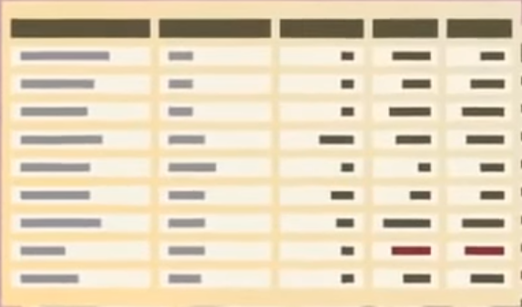
Distributed
Shared
“Sibelius Monument” by Carlos ZGZ @ flickr

Slide 9
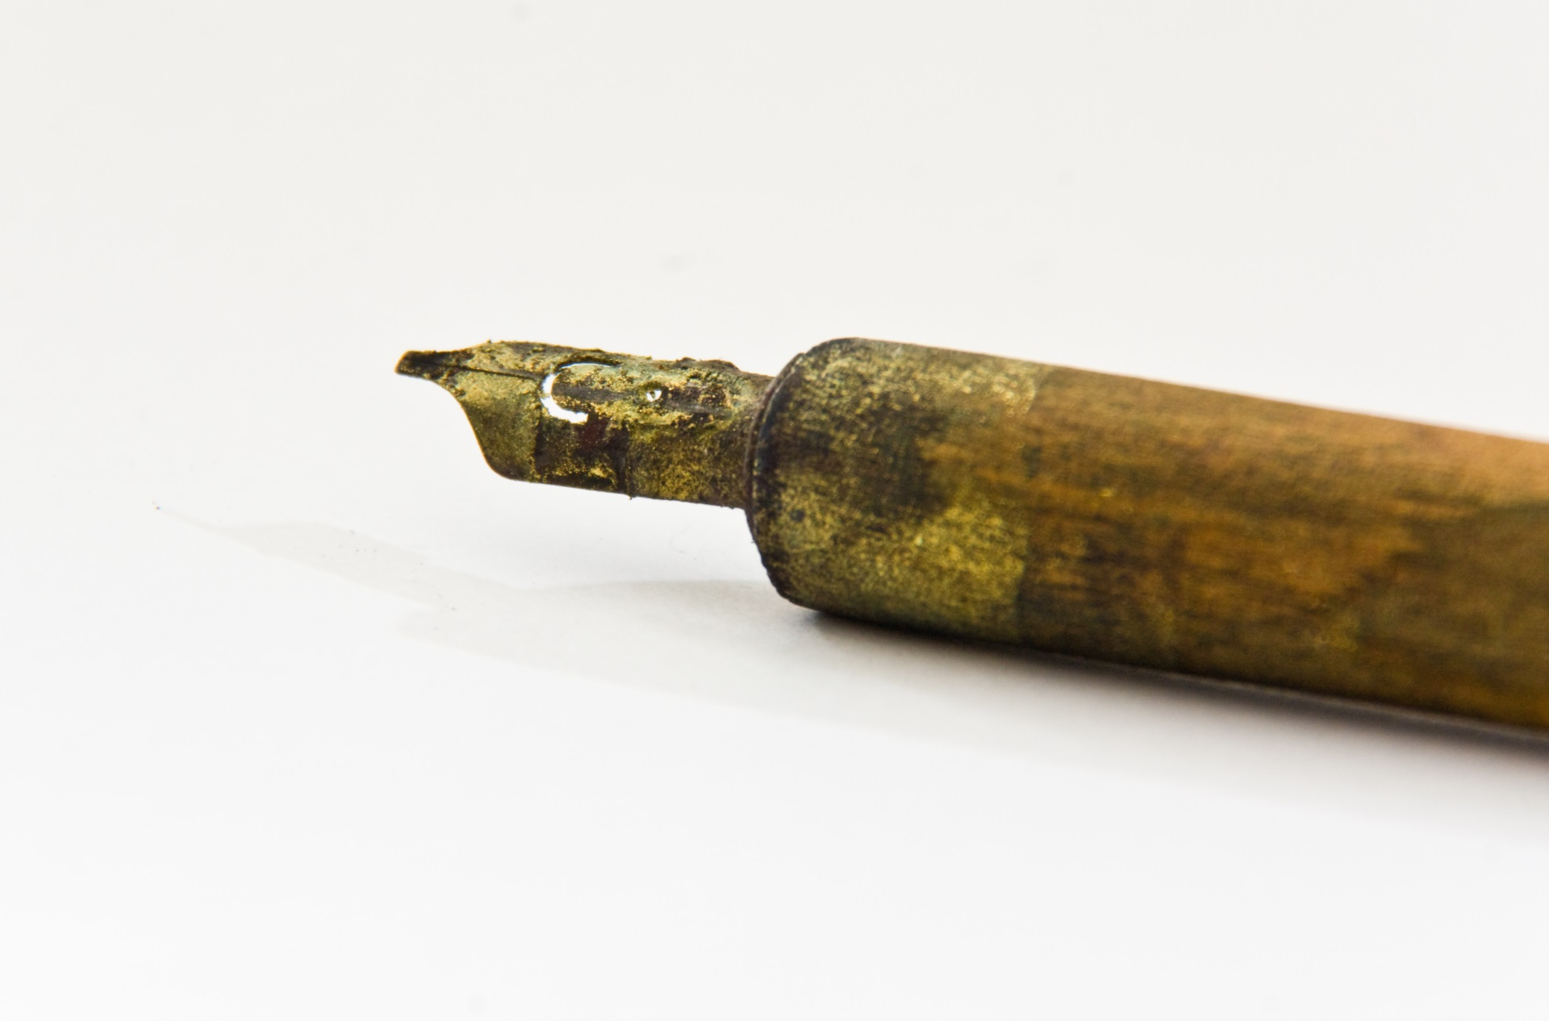
Immutable
“Written in Gold” (CC BY 2.0) by Anonymous Account @ flickr

Slide 10

Cryptography
"Bletchley Park" (CC BY 2.0) by Cargo Cult @ flickr

Slide 11
Demo Make a hash of it

Slide 12

Open
Anonymised
"Schooling" (CC BY-SA 2.0) by Benson Kua @ flickr

Slide 13
Demo Blockchain in action
http://ethstats.net/
http://etherscan.io/

Slide 14
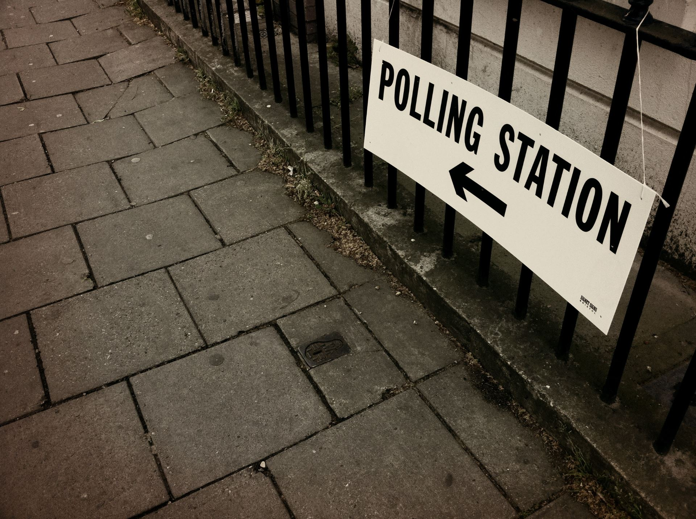
Consensus
"May 5: Vote" (CC BY-SA 2.0) by pjohnkeane @ flickr

Slide 15

Trust
"Trust" (CC BY 2.0) by schmollmolch @ flickr

Slide 16
Why should I care?

Slide 17
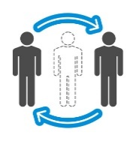
Potential for disruption
Eliminates Intermediaries
Allows industries to redefine or create new business models.
Reduces Fraud
Highly secure and transparent, making it nearly impossible to change historical records.
Increases Efficiency and Speed
Simplifies transactions and enables T+Zero settlement time.
Increases Revenue and Savings
Potential savings and new revenue opportunities through more efficient processes and reduced costs.

Slide 18
Consider the “Sharing Economy”
“Enabling people to share and monetize their assets, skills and time”
Airbnb – I rent out “spare capacity” in my oh-so-trendy Paris apartment
Etsy – I sell the output of my crocheting obsession
EasyCar Club – I rent out the 911 when I’m in the Lambo
Uber – I proffer my skills, time and asset for modest reward
Democratising? Undeniably yet these are centralised models…
Blockchain could potentially redefine the sharing economy
Disintermediation means lower costs, greater efficiency, greater transparency
Marketplaces become distributed applications on the blockchain
Smart contracts executing transactions

Slide 19

It’s not
just
about
money
"money 1" (CC BY-SA 2.0) by allenthepostman @ flickr

Slide 20
“The first generation of the digital revolution brought us the Internet of information. The second generation — powered by blockchain technology — is bringing us the Internet of value: a new platform to reshape the world of business and transform the old order of human affairs for the better.” – Don Tapscott

Slide 21
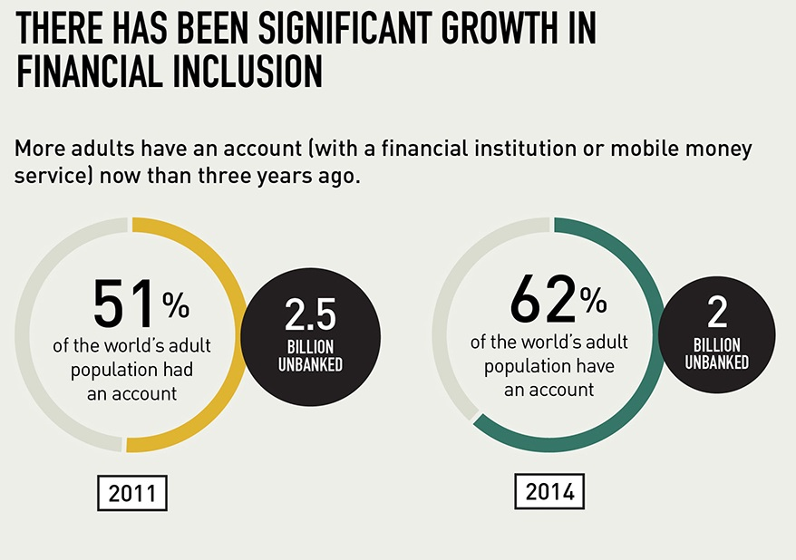
Global Findex 2014 infographic courtesy of The World Bank

Slide 22
How does it work?

Slide 23
0x4fb8…
Jeremy
0xe618…
Geoff
0x88d2…
Transaction x
0xa37dcd8d2f8bb9f…
New Block
Previous Block
0x09aa5...
Transaction 9
Transaction 8
Transaction 7
Transaction 6

Slide 24
The chain forms
Block 0 (0x23e79…)
Block 1 (0x09aa5……)
Block 2 (0x7b5…)
Genesis Block
Previous Block
0x23e79...
Previous Block
0x09aa5...
Transaction 9
Transaction 3
Transaction 8
Transaction 2
Transaction 5
Transaction 7
Transaction 1
Transaction 4
Transaction 6

Slide 25
Blockchain x.0

Slide 26
Smart Contracts
Blockchain 2.0
+ Smart Contracts
Logic Tier
Blockchain 1.0
Simple Ledgers that record transactions

Slide 27
Real World Smart Contracts

Slide 28
Smart Contracts
Like a physical contract but terms are converted into code and loaded onto the Blockchain
Smart Contracts enforce themselves because they live on the blockchain
Smart Contracts react to events and messages, include complex multiparty actions and actually transfer assets between parties.
Think of a Smart Contract as a program running on the Blockchain that will continue running until it expires. This contract will leave a complete historical ledger of all of its interactions along with the identities of those interacting with it so it is completely transparent for auditing purposes.

Slide 29

Smart Contracts
Blockchain 3.0
+ Cloud Servicing
Multilayer Middleware
+ Cryptlets
Blockchain 2.0
+ Smart Contracts
Logic Tier
Blockchain 1.0
Simple Ledgers that record transactions

Slide 30
Types of blockchain

Slide 31
Public vs Consortium
Public
Unpermissioned (eg Bitcoin, Ethereum)
Anyone has access
No single owner – all participants are “owners”
Anyone can verify transactions and consensus is used to determine “truth”
Consortium
Permissioned Public (eg Ripple)
Anyone has access
One or many “owners”
Only designated actors can verify transactions and achieve consensus
Permissioned Private (eg Bankchain)
Access to the ledger is restricted
One or many “owners”
Only designated actors can verify transactions and achieve consensus

Slide 32
Characteristics
Distributed, peer to peer network architecture
Cryptographic tokens
Shared database / ledger (everyone has a copy)
Blocks of transactions to start of time (genesis block)
Immutable
Heartbeat – blocks are committed
Consensus formation algorithm
Virtual machine

Slide 33
Consensus Forming Approach
Consensus requires participants with vested interest
Proof of work (need to solve a puzzle)
Proof of stake (I can demonstrate I own some stake in the system)
Proof of burn (I’m prepared to make a sacrifice to participate)
It must come at a cost but be easy to verify (asymmetric)

Slide 34


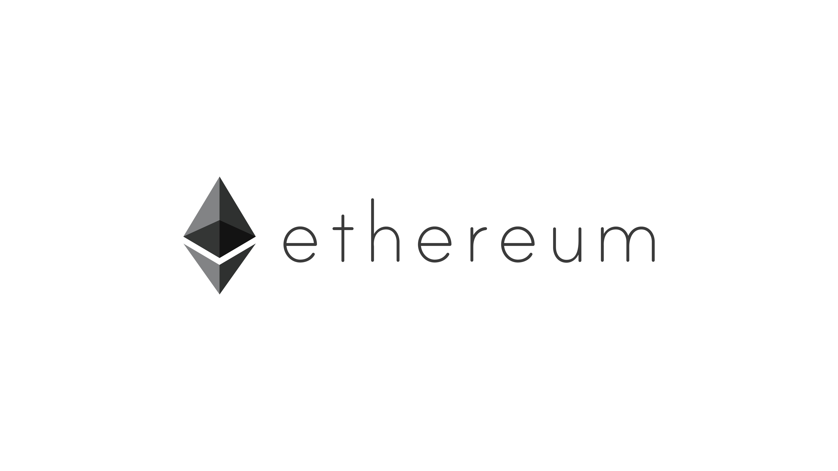


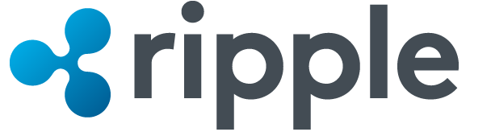
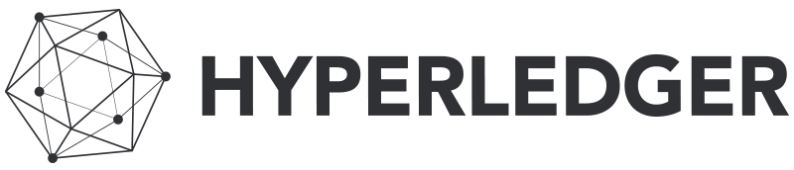

Slide 35
Potential applications

Slide 36



And it will disrupt multiple industries
Financial
Redesign costly legacy workflows, improve liquidity and free up capital. Help reduce infrastructure costs, increase transparency, reduce fraud and improve execution and settlement times.
Healthcare
Removes third-party verifiers such as health information exchanges by directly linking patient records to clinical and financial stakeholders. Provides fast, secure, authenticated access to personal medical records across healthcare organizations and geographies.
Government
Increase transparency and traceability of how money is spent. Track asset registration, such as vehicles. Reduce fraud and operational costs.
Retail & Manufacturing
Better supply chain management, smart contract platforms, digital currencies, and tighter cybersecurity.

Slide 37
New solutions to difficult business problems
Financial
Trading
Deal origination
POs for new securities
Equities
Fixed income
Derivatives trading
Total Return Swaps (TRS)
2nd generation derivatives
The race to a zero middle office
Collateral management
Settlements
Payments
Transferring of value
Know your client (KYC) Anti money laundering
Client and product reference data.
Crowd Funding
Peer-to-peer lending
Compliance reporting
Trade reporting & risk visualizations
Betting & prediction markets
Insurance
Claim filings
MBS/Property payments
Claims processing & admin
Fraud prediction
Telematics & ratings
Media
Digital rights mgmt
Game monetization
Art authentication
Purchase & usage monitoring
Ticket purchases
Fan tracking
Ad click fraud reduction
Resell of authentic assets
Real time auction & ad placements
Computer Science
Micronization of work (pay for
algorithms, tweets, ad clicks, etc.)
Expanse of marketplace
Disbursement of work
Direct to developer payments
API platform plays
Notarization & certification
P2P storage & compute sharing
DNS
Medical
Records sharing
Prescription sharing
Compliance
Personalized medicine
DNA sequencing
Asset Titles
Diamonds
Designer brands
Car leasing & sales
Home Mortgages & payments
Land title ownership
Digital asset records
Government
Voting
Vehicle registration
WIC, Vet, SS, benefits, distribution
Licensing & identification
Copyrights
Identity
Personal
Objects
Families of objects
Digital assets
Multifactor Auth
Refugee tracking
Education & badging
Purchase & review tracking
Employer & Employee reviews
IoT
Device to Device payments
Device directories
Operations (e.g. water flow)
Grid monitoring
Smart home & office management
Cross-company maintenance markets
Payments
Micropayments (apps, 402)
B2B international remittance
Tax filing & collection
Rethinking wallets & banks
Consumer
Digital rewards
Uber, AirBNB, Apple Pay
P2P selling, craigslist
Cross company, brand, loyalty tracking
Supply Chain
Dynamic commodities pricing
Real time auction for supply delivery
Pharmaceutical tracking & purity
Agricultural food authentication
Shipping & logistics management

Slide 38
Nimbrix

Slide 39
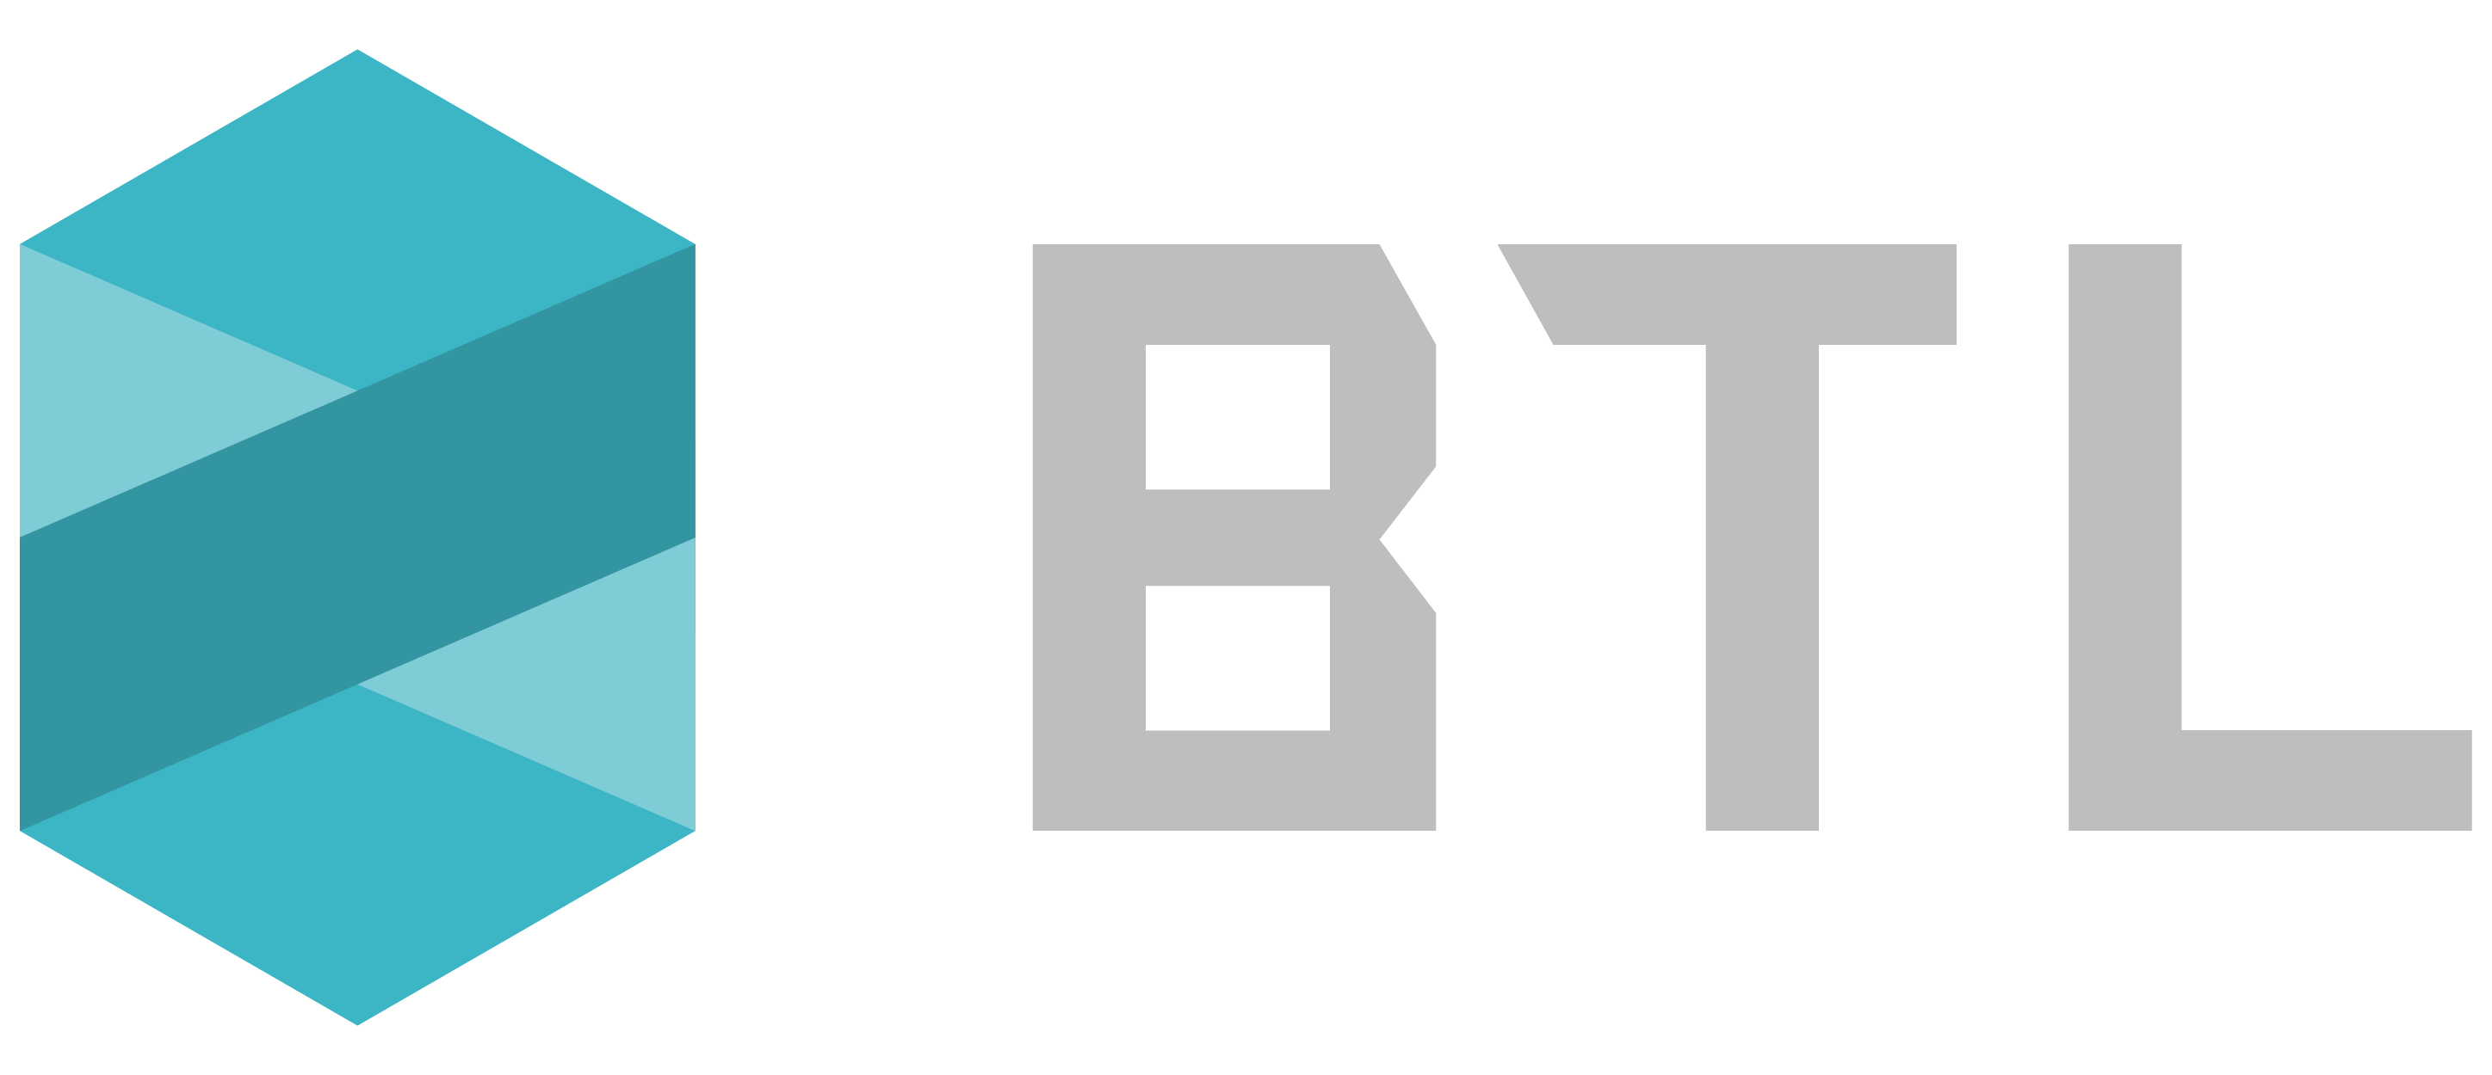
BTL Group Ltd (TSXV:BTL)
What do we do?
Several pilots in flight including cross-border settlement platform with Visa and a group of European banks
Our platform is live with FansUnite (fansunite.com) providing customers with provable receipts of bets they place
Why blockchain?
Interbit platform, built on blockchain technology, delivers irrefutable proof whether bets have been modified by a gaming company
FansUnite is able to differentiate from competitors by proving to their customers they can be trusted and can’t modify sensitive game data

Slide 40

Berkshire Cloud Ltd
What do we do?
Berkshire Cloud is an ISV and bespoke software developer specialising in the Azure cloud platform and mobilisation of enterprise workflows
Berkshire Cloud is delivering an Immutable ‘Provenance as a Service’ database for IOT devices
Why blockchain?
Berkshire Cloud’s ’Provenance as a Service’ database logs IOT device provenance data and device history data in an immutable form onto a blockchain infrastructure

Slide 41
Microsoft and blockchain

Slide 42
Open
Platform
Accessible
Enterprise
Ready

Slide 43




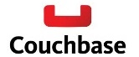










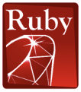










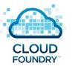





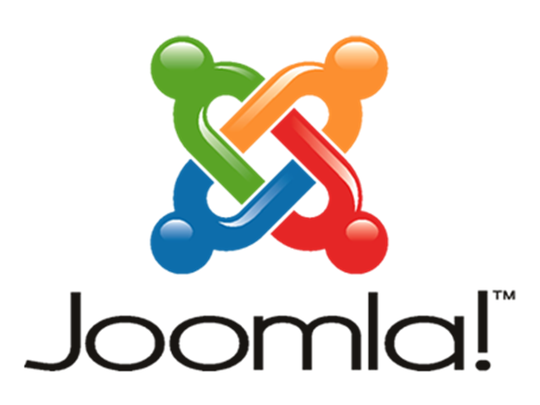





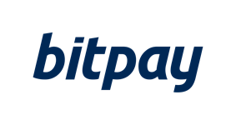









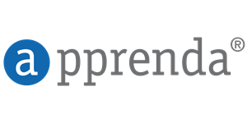




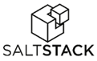
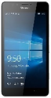
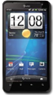




Microsoft Azure | An Open Cloud
Infrastructure
Databases
App Frameworks
Hyper Scale
Enterprise Grade
Hybrid
We’ve delivered an open, broad, and flexible cloud across the stack
SQL Server
Azure BaaS
+Hundreds of community supported images on VM Depot
Applications
Management
Clients
Web App Gallery
Dozens of .NET & PHP CMS and Web apps

Slide 44


























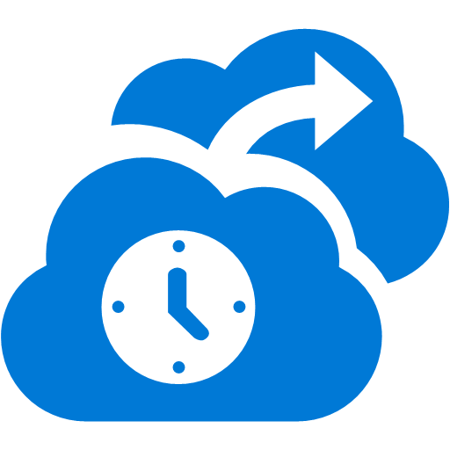







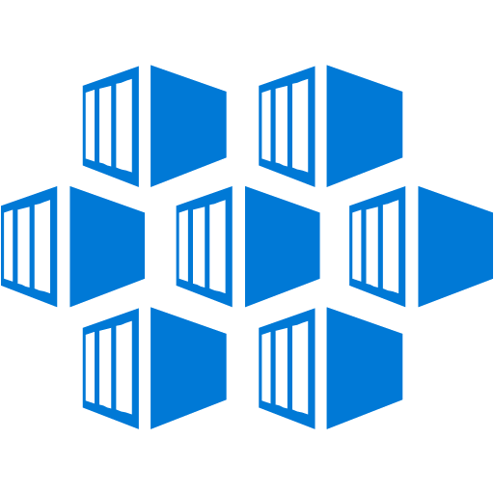























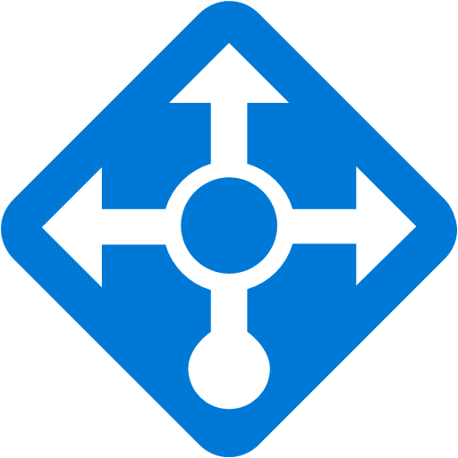

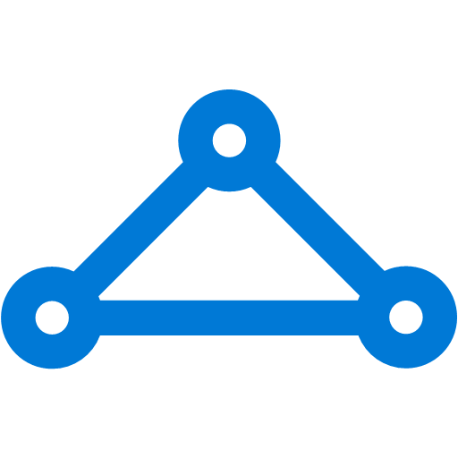



Platform Services
Security & Management
Hybrid
Cloud
Media & CDN
Application Platform
Data
Security Center
SQL
Database
Azure AD
Health Monitoring
Media Services
Media Analytics
Content Delivery
Network
Web
Apps
Mobile
Apps
SQL Data
Warehouse
DocumentDB
Portal
AD Privileged
Identity
Management
Azure Active
Directory
Integration
SQL Server
Stretch Database
Redis
Cache
Storage
Tables
Azure
Search
API
Apps
Cloud
Services
Azure AD
B2C
API
Management
BizTalk
Services
Domain Services
Service
Fabric
Notification
Hubs
Intelligence
Multi-Factor
Authentication
Logic
Apps
Service Bus
Functions
Cognitive Services
Bot Framework
Cortana
Backup
Automation
Developer Services
Analytics & IoT
Operational
Analytics
Compute Services
Scheduler
HDInsight
Machine
Learning
Stream Analytics
Container
Service
VM
Scale Sets
Visual Studio
Mobile
Engagement
Import/Export
Key Vault
Data
Catalog
Data Lake
Analytics Service
Data Lake Store
Store/
Marketplace
Batch
RemoteApp
VS Team Services
Xamarin
Azure Site
Recovery
Application
Insights
HockeyApp
IoT Hub
Event
Hubs
Data
Factory
Power BI
Embedded
VM Image Gallery
& VM Depot
Dev/Test Lab
StorSimple
Infrastructure Services
Compute
Storage
Networking
Virtual Machines
Containers
Blob
Queues
Files
Disks
Virtual Network
Load Balancer
DNS
Express
Route
Traffic Manager
VPN Gateway
App
Gateway
Datacenter Infrastructure (32 Regions, 24 Online)

Slide 45
Tenets of our Strategy
FAIL FAST & CHEAP
in a development test environment
MIX & MATCH from the best available blockchain technologies
CREATE & INNOVATE
by building solutions on blockchain quickly
SHARE SOLUTIONS through a worldwide distributed platform
PROVISION with one-click to test & iterate

Slide 46




Project “Bletchley”
POCs
Banking, Capital Markets
Discrete Manufacturing
Retail & CPG
Healthcare
Government
Build and learn
Professional Services & Support
Industry Solutions
Horizontal SaaS & Adapters
1st Party
3rd Party
3rd Party
3rd Party
…..
Develop key Azure middleware services
Distributed Ledger Gateway Services
Identity & Key Services
Encryption Services
ML & BI
Services
Middleware
Crypto services & architecture (secure containers, attestation, etc.)
Grow the ecosystem
Smart Contract-Based Distributed Ledger Stacks
UTXO + others
Blockchain Virtual Machine
Adapters
Base Platform
1st party DL Stack
3rd party DL stack A
3rd party DL stack B
3rd party DL stack C…
Azure – Blockchain resource provider

Slide 47

Create a tight feedback loop between POCs & MS engineering to enable quick iterations on our offerings
POCs
Industry Solutions
Banking, Capital Markets
Discrete Manufacturing
Retail & CPG
Healthcare
Government
Learn quickly, discover customer needs, and galvanize partners through POCs
Influence and adjust Blockchain product design and roadmap
Distributed Ledger Gateway Services
Identity & Key Services
Encryption Services
ML & BI
Services
Middleware
Engineering
Crypto services & architecture (secure containers, attestation, etc.)
Smart Contract-Based Distributed Ledger Stacks
UTXO + others
Blockchain Virtual Machine
Adapters
Base Platform
1st party DL Stack
3rd party DL stack A
3rd party DL stack B
3rd party DL stack C…
Azure – Blockchain resource provider

Slide 48

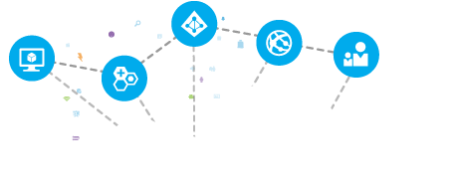
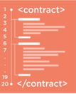

Drive partner innovation and scale by providing blockchain tools and pre-configured solutions through or marketplaces
Promote engagement and innovation by onboarding ISVs into Azure Marketplace and AppSource
Enable customers and partners to discover, publish and transact blockchain components and services from smart contracts to complete SaaS offerings
Azure Marketplace and AppSource with 3rd party solutions, smart contracts, and other blockchain components
cryptlet
cryptlet

Slide 49
Build enterprise-ready blockchain middleware
POCs
Banking, Capital Markets
Discrete Manufacturing
Retail & CPG
Healthcare
Government
Distributed Ledger Gateway Services
Provides communication between multiple Blockchain technologies/implementations.
Identity and Key Services
Helps with authentication, authorization, access, and lifecycle management.
Encryption Services
Provides encryption for blockchain transactions and fields
Cryptlet Services
Provides runtime for cryptlets and communication between blockchain and cryptlet trusted host
Machine Learning and Business Intelligence
Rich data services, such as BI analytics, auditing, and machine learning
Professional Services & Support
Industry Solutions
Horizontal SaaS & Adapters
1st Party
3rd Party
3rd Party
3rd Party
…..
Distributed Ledger Gateway Services
Identity & Key Services
Encryption Services
ML & BI
Services
Middleware
Crypto services & architecture (secure containers, attestation, etc.)
Smart Contract-Based Distributed Ledger Stacks
UTXO + others
Blockchain Virtual Machine
Adapters
Base Platform
1st party DL Stack
3rd party DL stack A
3rd party DL stack B
3rd party DL stack C…
Azure – Blockchain resource provider

Slide 50
Get started
SIGN UP FOR AN AZURE ACCOUNT
https://azure.microsoft.com/
READ ABOUT BLOCKCHAIN ON AZURE
https://azure.microsoft.com/en-gb/solutions/blockchain/
TRY THE CONSORTIUM BLOCKCHAIN TEMPLATE
https://azure.microsoft.com/en-us/blog/project-bletchley-blockchain-infrastructure-made-easy/
FIND OUT MORE ABOUT PROJECT ‘BLETCHLEY’
https://github.com/Azure/azure-blockchain-projects/tree/master/Bletchley/

Slide 51
Thank you

